Slide 1
National Focal Points for Public Health Training
5 March 2024, Virtual call

Slide 2
Welcome and objectives of the session Adam Roth

Slide 3
Agenda
 | Welcome and objectives of the session Adam Roth, Head of Section Public Health Training | 13:00 – 13:05
Part I | Ways of working with the network in 2024 Jeanine Pommier, Group Leader Continuous Professional Development Reminder on the role of NFPTs as stated in the Terms or Reference – 10’, Urszula Bogatynska, Training Support Specialist Presentation of survey results – 10‘, Urszula Bogatynska, Training Support Specialist Update from TSF discussion on 15 February about ways of working – 5’, Adam Roth, Head of Section Public Health Training Discussion linked with survey results (break-out rooms) | 13:05 – 14:30
Break |  | 14:30 – 14:45
Part II | Information item on Fellowship topics and Q&A Adam Roth, Head of Section Public Health Training How Fellowship will be included in EU Health Task Force (when/voluntary or obligatory participation/administrative processes) - Emma Löf, on behalf of the ECDC Coordination Team of the EU Health Task Force Selection of C2024 and requirements for MS Track | 14:45 – 15:15
Closure | AOB EVA catalogue 2024 Summer School 2024 Recovery e-learning | 15:15 –15:30

Slide 4
Ways of working with the network in 2024

Slide 5
Reminder on the role of NFPTs as stated in the Terms or Reference Urszula Bogatynska

Slide 6
Background information
All information is available under Coordinating-Competent-Bodies-Structures-Terms-of-reference-and-interactions_2023.pdf (including Annexes 5, 7 and 9)
High-level relations and coordination interactions between ECDC and the Coordinating Competent Bodies (CCBs) are at the level of the CCB Director and National Coordinators, following necessary and appropriate consultation in the country
Strategic and overarching interactions related to a specific disease group or public health function are at the level of the National Focal Points, following necessary and appropriate consultation in the country.
Technical and operational interactions related to specific area within the domains of a disease group or public health function are at the level of the Operational Contact Points (OCPs), following necessary and appropriate consultation in the country.
Notes:
List of Annexes
Terms of Reference for the Director of the Coordinating Competent Body in EU/EEA Member States
2. Terms of Reference for the National Coordinator in the Coordinating Competent Body in EU/EEA Member States.
3. Terms of Reference for ECDC National Coordinators Coordination Committee in EU/EEA Member States.
4. Terms of Reference for ECDC National Focal Points for Disease Groups in EU/EEA Member States.
5. Terms of Reference for ECDC National Focal Points for Public Health Functions in EU/EEA Member States.
6. Terms of Reference for ECDC Operational Contact Points for Disease-Specific Interactions in EU/EEA Member States
7. Terms of Reference for ECDC Operational Contact Points for Public Health Training in field epidemiology (EPIET) and public health microbiology (EUPHEM) as organised in the ECDC Fellowship Training Site Forum (TSF)
8. Terms of Reference for ECDC Disease Network Coordination Committees in EU/EEA Member States.
9. Terms of Reference for ECDC Public Health Network Coordination Committees in EU/EEA Member States. 10. Terms of Reference for Network for the Microbial Safety of Substances of Human Origin (SoHO)

Slide 7
Composition of National Focal Points for Public Health Training and Training Site Forum
NFPTs (Members and Alternates)
Responsible for overseeing interactions between ECDC and the Member State regarding the activities related to the public health function.
TSF
Represent acknowledged training sites
Platform for interaction between the training sites, the NFPTs and the Public Health Training Section at ECDC in order to provide special expertise regarding fellowship activities
Operational Contact Points (OCPs):
One representative proposed by each of the acknowledged training sites for each of the EPIET or EUPHEM paths
Non-operational Contact Points (non-OCPs):
Two representatives from the EAN board, if possible, an alumnus from each of the EPIET and EUPHEM paths,
Two representatives from the current Fellowship Cohorts, one from the EPIET path and one from the EUPHEM path,
Scientific Coordinators of the Fellowship Programme and staff from the ECDC Public Health Training Section
Supervisors of the fellows currently under training.
56 NFPTs
(30 Members and 26 Alternates) out of which 18 holding also OCP role
52 OCPs
(34 EPIET and 18 EUPHEM)
out of which 36 holding also Supervisor role
Notes:
Operational Contact Points (OCPs):
The OCPs are recognised representatives of the ECDC CCB structure.
One representative proposed by each of the acknowledged training sites for each of the EPIET or EUPHEM paths, formally nominated to ECDC by the respective National Coordinator (NC) or by delegation, by the NFPT
Non-OCP representatives:
Two representatives from the EAN board, if possible, an alumnus from each of the EPIET and EUPHEM paths,
Two representatives from the current Fellowship Cohorts, one from the EPIET path and one from the EUPHEM path,
Scientific Coordinators of the Fellowship Programme and staff from the ECDC Public Health Training Section
Supervisors of the fellows currently under training.
Some of the members hold several functions and join different activities/meeting in different capacity.
Altogether 56 NFPTs out of which 18 holding also OCP role
52 OCPs role out of which 36 Supervisors also acting as Supervisors or Co-Supervisors

Slide 8
Roles of NFPTs and TSF
NFPTs
Provide feedback on implementation to practice of knowledge and skills obtained by training, evaluation of training efficiency, development of lists of core competencies in public health disciplines, etc.);
Advise ECDC regarding selection/prioritisation of participants to ECDC training activities;
Participate in or identify experts for other training-related activities (e.g. training needs assessment, evaluation of training programmes/training sites).
Provide strategic advice and suggestions for future developments of EPIET, EUPHEM and similar training programmes;
Advise on implementation and review of the EPIET, EUPHEM training objectives;
TSF
provide technical input from training sites in terms of feedback on the curriculum and current programme (e.g., on administration, communication, training resources and tools, preparation and execution of modules, including proposing suitable venue, etc.);
identify and inform about training needs for fellows, supervisors and facilitators;
participate in the selection of fellows and facilitators;
advise on relevance and applicability of training objectives and graduation criteria;
advise on fellowship selection criteria and process;
provide advice, input and guidance for the site visit process;
advise on the timing of the curricular cycle
Notes:
In order to ensure efficient communications between ECDC and the Coordinating Competent Body, the NFP for Training is specifically responsible for :
Provide feedback on implementation to practice of knowledge and skills obtained by training, evaluation of training efficiency, development of lists of core competencies in public health disciplines, etc.);
Provide strategic advice and suggestions for future developments of EPIET, EUPHEM and similar training programmes;
Advise ECDC regarding selection/prioritisation of participants to ECDC training activities;
Advise on implementation and review of the EPIET, EUPHEM training objectives;
Participate in or identify experts for other training-related activities (e.g. training needs assessment, evaluation of training programmes/training sites).

Slide 9
PHT Coordination Committee – Members (till Feb 2026)
Alpers Katharina, NFPT Member, Germany
Antoljak Natasa, NFPT Member, Croatia
D’Ancona Paolo, NFPT Member, Italy
Herrera Leon Silvia, NFPT Alternate, Spain
Orlikova Hana, NFPT Member, Czechia
Rangelova Vanya, NFPT Member, Bulgaria
Strauß Reinhild, NFPT Member, Austria
Weber Julia, NFPT Alternate, Austria
Tzanakaki Georgina, OCP for Public Health Training Epidemiology (EUPHEM), Chair of TSF Committee of Four (EUPHEM), Greece
Kortbeek Titia, OCP for Public Health Training Epidemiology (EUPHEM), Co-Chair of TSF Committee of Four (EUPHEM), Netherlands
Fitzgerald Margaret, OCP for Public Health Training Epidemiology (EPIET), Chair of TSF Committee of Four (EPIET), Ireland
Mellou Kassiani, OCP for Public Health Training Epidemiology (EPIET), Co-Chair of TSF Committee of Four (EPIET), Greece
TSF
Committee of Four
supports further development of the ECDC public health work and networks by providing important but non-binding advice to the relevant ECDC units thus enabling the network to improve its effectiveness and added value
Notes:
Public Health Training Coordination Committee – Composition (appointment February 2023)
Role
supports further development of the ECDC public health work and networks, by providing important but non-binding advice to the relevant ECDC units thus enabling the network to improve its effectiveness and added value
consists of a maximum of 10 members (the final number will be decided by each network) selected from and representing all the NFPs and OCPs for a specific public health function, to mirror the broad scope of activities to be addressed by the PHNCCs (Public Health Network Coordination Committees).
Complementary to consultations with the full network, the Committee will specifically provide support to the following
provide advice on the implementation of strategies and annual section work plans;
provide rapid advice to ECDC on scientific/technical issues within the public health function, as requested;
contribute to the identification of Member States’ needs in terms of strengthening capacity in the area of the public health function.
review selected technical reports and documents produced by the ECDC or its contractors and make suggestions for improvement, as requested;
contribute to the agenda of the annual meetings of the network (including identifying topics; key note speakers, working group sessions and others);
review the methodologies to improve specific data collections, data presentation and interpretation of project results;
review the need for specific public health function working groups, advisory groups, ad hoc expert panels and task forces which would report to the Committee on specific issues (i.e. specific pilot projects and research initiatives);
closely liaise with any other ECDC Committee or Working Groups that may be set up to work on technical issues in the public health function at hand;
liaise with ECDC Disease Network Coordination Committees on important shared topics as relevant
Committee of Four – role
The TSF will elect one chairperson and one co-chairperson from among the representatives of acknowledged training sites for each one of the paths (EPIET and EUPHEM).
The two chairpersons contribute to co-chairing the annual meetings and will serve as main contact points with the ECDC PHT section.
The co-chairperson will serve in the same capacity as the chairperson of the respective path in his/her absence.
Together, the chairpersons and co-chairpersons will form a “Committee of four”. This committee will:
draft the agenda of the yearly meetings, supported by the PHT section
propose improvements to the fellowship programme; and
participate in strategic discussions regarding the focus of the Fellowship Programme. The committee of four is also part of the Public Health Training Coordination Committee

Slide 10
Reminder on the role of NFPTs as stated in the Terms or Reference More information (not presented during the meeting)

Slide 11
General information
All information is available under Coordinating-Competent-Bodies-Structures-Terms-of-reference-and-interactions_2023.pdf
High-level relations and coordination interactions between ECDC and the CCBs are at the level of the CCB Director and NCs, following necessary and appropriate consultation in the country
Strategic and overarching interactions related to a specific disease group or public health function are at the level of the NFPs, following necessary and appropriate consultation in the country.
Technical and operational interactions related to specific area within the domains of a disease group or public health function are at the level of the OCPs, following necessary and appropriate consultation in the country.
(page 7 of ECDC Coordinating Competent Bodies: Structures, Interactions and Terms of Reference)

Slide 12
Appointment of the National Focal Points (NFP) for Public Health Training
The NFP is nominated by the National coordinator (NC) of the Coordinating competent body (CCB).
By delegation of the NC, the NFP is responsible for overseeing interactions between ECDC and the Member State regarding the activities related to the public health function.
If no NFP is nominated, all interactions within this area will remain channelled through the NC.

Slide 13
Role and Tasks of the National Focal Points (NFP) for Public Health Training
In order to ensure efficient communications between ECDC and the Coordinating Competent Body, the NFP for Training is specifically responsible for :
Provide feedback on implementation to practice of knowledge and skills obtained by training, evaluation of training efficiency, development of lists of core competencies in public health disciplines, etc.);
Provide strategic advice and suggestions for future developments of EPIET, EUPHEM and similar training programmes;
Advise ECDC regarding selection/prioritisation of participants to ECDC training activities;
Advise on implementation and review of the EPIET, EUPHEM training objectives;
Participate in or identify experts for other training-related activities (e.g. training needs assessment, evaluation of training programmes/training sites).

Slide 14
Role and Tasks of the National Focal Points – General Responsibilities (same for all NFPs)
In liaison with the NC, and with other relevant NFPs from their country, identify and advise the NC on nominations of additional experts to serve as OCP for specific technical interactions with ECDC;
Advise the NC on nominations to ECDC ad hoc working groups and other meetings within his/her area;
Contribute/provide input into the development/revisions of ECDC strategies within his/her public health function;
Contribute/provide input into the development of the ECDC annual work programme priorities within his/her public health function;
Contribute to the implementation of evidence-based methods in public health;
Provide technical advice on specific project proposals within his/her public health function;
Provide available information, according to agreements adopted in the network, about the current situation and status of activities/capacities and national programmes within his/her public health function in the Member State as needed (including legislation);
Contribute to the identification of Member State’s needs for strengthening capacity within his/her public health function;
Provide strategic advice and suggestions to ECDC regarding further development of networks within his/her public health function;
Provide strategic advice and suggestions for ECDC work within his/her public health function;
Advise ECDC on any ad hoc issues within his/her area;
Oversee all other interactions between ECDC and the Member State concerning issues within his/her public health function;
Participate in ECDC activities within his/her public health function, unless delegated to Operational Contact Points.
Participate in ECDC consultations within his/her a public health function and provide feedback;
Assist in building awareness and disseminating information within his/her function;
Liaise with ECDC contact points on matters related to ECDC country visits related to his/her public health function; Liaise with ECDC contact points on country’s requests on matters related to his/her public health function.

Slide 15
PHT Coordination Committee
supports further development of the ECDC public health work and networks, by providing important but non-binding advice to the relevant ECDC units thus enabling the network to improve its effectiveness and added value
consists of a maximum of 10 members (the final number will be decided by each network) selected from and representing all the NFPs and OCPs for a specific public health function, to mirror the broad scope of activities to be addressed by the PHNCCs (Public Health Network Coordination Committees).
Notes:
Public Health Training Coordination Committee – Composition (appointment February 2023)
Alpers Katharina, NFPT Member, Germany
Antoljak Natasa, NFPT Member, Croatia
D’Ancona Paolo, NFPT Member, Italy
Fitzgerald Margaret, OCP for Public Health Training Epidemiology (EPIET), Chair of TSF Committee of Four (EPIET), Ireland
Mellou Kassiani, OCP for Public Health Training Epidemiology (EPIET), Co-Chair of TSF Committee of Four (EPIET), Greece
Herrera Leon Silvia, NFPT Alternate, Spain
Orlikova Hana, NFPT Member, Czechia
Rangelova Vanya, NFPT Member, Bulgaria
Strauß Reinhild, NFPT Member, Austria
Tzanakaki Georgina, OCP for Public Health Training Epidemiology (EUPHEM), Chair of TSF Committee of Four (EUPHEM), Greece
Kortbeek Titia, OCP for Public Health Training Epidemiology (EUPHEM), Co-Chair of TSF Committee of Four (EUPHEM), Netherlands
Weber Julia, NFPT Alternate, Austria

Slide 16
PHT Coordination Committee - Members
Alpers Katharina, NFPT Member, Germany
Antoljak Natasa, NFPT Member, Croatia
D’Ancona Paolo, NFPT Member, Italy
Herrera Leon Silvia, NFPT Alternate, Spain
Orlikova Hana, NFPT Member, Czechia
Rangelova Vanya, NFPT Member, Bulgaria
Strauß Reinhild, NFPT Member, Austria
Weber Julia, NFPT Alternate, Austria
Tzanakaki Georgina, OCP for Public Health Training Epidemiology (EUPHEM), Chair of TSF Committee of Four (EUPHEM), Greece
Kortbeek Titia, OCP for Public Health Training Epidemiology (EUPHEM), Co-Chair of TSF Committee of Four (EUPHEM), Netherlands
Fitzgerald Margaret, OCP for Public Health Training Epidemiology (EPIET), Chair of TSF Committee of Four (EPIET), Ireland
Mellou Kassiani, OCP for Public Health Training Epidemiology (EPIET), Co-Chair of TSF Committee of Four (EPIET), Greece
Notes:
Public Health Training Coordination Committee – Composition (appointment February 2023)
Alpers Katharina, NFPT Member, Germany
Antoljak Natasa, NFPT Member, Croatia
D’Ancona Paolo, NFPT Member, Italy
Fitzgerald Margaret, OCP for Public Health Training Epidemiology (EPIET), Chair of TSF Committee of Four (EPIET), Ireland
Mellou Kassiani, OCP for Public Health Training Epidemiology (EPIET), Co-Chair of TSF Committee of Four (EPIET), Greece
Herrera Leon Silvia, NFPT Alternate, Spain
Orlikova Hana, NFPT Member, Czechia
Rangelova Vanya, NFPT Member, Bulgaria
Strauß Reinhild, NFPT Member, Austria
Tzanakaki Georgina, OCP for Public Health Training Epidemiology (EUPHEM), Chair of TSF Committee of Four (EUPHEM), Greece
Kortbeek Titia, OCP for Public Health Training Epidemiology (EUPHEM), Co-Chair of TSF Committee of Four (EUPHEM), Netherlands
Weber Julia, NFPT Alternate, Austria

Slide 17
PHT Coordination Committee - role
Complementary to consultations with the full network, the Committee will specifically provide support to the following
provide advice on the implementation of strategies and annual section work plans;
provide rapid advice to ECDC on scientific/technical issues within the public health function, as requested;
contribute to the identification of Member States’ needs in terms of strengthening capacity in the area of the public health function.
review selected technical reports and documents produced by the ECDC or its contractors and make suggestions for improvement, as requested;
contribute to the agenda of the annual meetings of the network (including identifying topics; key note speakers, working group sessions and others);
review the methodologies to improve specific data collections, data presentation and interpretation of project results;
review the need for specific public health function working groups, advisory groups, ad hoc expert panels and task forces which would report to the Committee on specific issues (i.e. specific pilot projects and research initiatives);
closely liaise with any other ECDC Committee or Working Groups that may be set up to work on technical issues in the public health function at hand;
liaise with ECDC Disease Network Coordination Committees on important shared topics as relevant

Slide 18
Training Site Forum

Slide 19
Composition and role of the TSF
The TSF represents acknowledged training sites.
The definition of an acknowledged training site is published in the Administrative Decision of the ECDC Fellowship Programme and is periodically revised in consultation with the TSF and NFPT
The TSF has no decision-making function.
It is an expert group whose role is to provide special expertise, advice and guidance on scientific and practical matters relevant to the ECDC Fellowship Programme, and feedback on administrative operations.
It looks backwards in terms of outputs and evaluation and looks forward in terms of planning, curriculum development, and advice.

Slide 20
Composition of the TSF
Operational Contact Points (OCPs):
The OCPs are recognised representatives of the ECDC CCB structure.
One representative proposed by each of the acknowledged training sites for each of the EPIET or EUPHEM paths, formally nominated to ECDC by the respective National Coordinator (NC) or by delegation, by the NFPT
Non-OCP representatives:
Two representatives from the EAN board, if possible, an alumnus from each of the EPIET and EUPHEM paths,
Two representatives from the current Fellowship Cohorts, one from the EPIET path and one from the EUPHEM path,
Scientific Coordinators of the Fellowship Programme and staff from the ECDC Public Health Training Section
Supervisors of the fellows currently under training.

Slide 21
Role and Tasks of the Training Site Forum
The role of the TSF is to be a platform for interaction between the training sites, the NFPTs and the Public Health Training Section at ECDC in order to provide special expertise regarding fellowship activities.
The TSF will:
provide technical input from training sites in terms of feedback on the curriculum and current programme (e.g., on administration, communication, training resources and tools, preparation and execution of modules, including proposing suitable venue, etc.);
identify and inform about training needs for fellows, supervisors and facilitators;
participate in the selection of fellows and facilitators;
advise on relevance and applicability of training objectives and graduation criteria;
advise on fellowship selection criteria and process;
provide advice, input and guidance for the site visit process;
advise on the timing of the curricular cycle

Slide 22
Committee of Four - role
The TSF will elect one chairperson and one co-chairperson from among the representatives of acknowledged training sites for each one of the paths (EPIET and EUPHEM).
The two chairpersons contribute to co-chairing the annual meetings and will serve as main contact points with the ECDC PHT section.
The co-chairperson will serve in the same capacity as the chairperson of the respective path in his/her absence.
Together, the chairpersons and co-chairpersons will form a “Committee of four”. This committee will:
draft the agenda of the yearly meetings, supported by the PHT section
propose improvements to the fellowship programme; and
participate in strategic discussions regarding the focus of the Fellowship Programme. The committee of four is also part of the Public Health Training Coordination Committee
Notes:
Fitzgerald Margaret, OCP for Public Health Training Epidemiology (EPIET), Chair of TSF Committee of Four (EPIET), Ireland
Mellou Kassiani, OCP for Public Health Training Epidemiology (EPIET), Co-Chair of TSF Committee of Four (EPIET), Greece
Tzanakaki Georgina, OCP for Public Health Training Epidemiology (EUPHEM), Chair of TSF Committee of Four (EUPHEM), Greece
Kortbeek Titia, OCP for Public Health Training Epidemiology (EUPHEM), Co-Chair of TSF Committee of Four (EUPHEM), Netherlands

Slide 23
Presentation of survey results Urszula Bogatynska

Slide 24
Overview of responses to the feedback survey (Response rate – 23%, 13 responses out of 56, by 23 February)
Please propose topics to be discussed among National Focal Points for Public Health Training in 2024.
Exchanges
Senior exchange mid-career trainings
Particularly interested in seeing exchange visits re-started. This type of peer-learning is hugely valuable to MS
Competencies
New needs/competencies for PH training at national and EU level
core competencies in public health disciplines,
Fellowship
How can we involve more people in the supervision process in the context of lack of specialist/ human resources? Could it be possible to have a MS track fellow in a different place/ city than the acknowledged training site, with a supervisor from the TS, having regular meeting face to face and online and with project supervisors from the place/ city where the fellow is based?"
collaboration with EPIET associated programmes (EAPs)
Specific topics
control measures to take when have to deal with a vector borne outbreak due to dengue/chikungunya or west Nile fever
balancing between preparedness and response
capacity assessment methodology
health task force

Slide 25
Do you have information needs that could be shared mainly through written communication (email/newsletter etc.)?
Updates EPIET/EUPHEM
Information linked to newsletter
Updates on training offers by ECDC (including information on preferred audiences)
info about new courses and public health conferences
the current newsletter is really good
Other
Minutes of the meetings, reports, news.
mainly information to be given to prevent further spread of a vector borne disease- actions to be taken by general population and government
I am rather new in this field, a monthly email with an overview of the main developments per subject would be helpful

Slide 26
Is there a practice or a challenge that you encounter in your Member State in relation to training and would like to share with other NFPTs for discussion? If 'Yes': Please share the topic and your name
In Sweden we are discussing how to reach a wider audience with training opportunities provided by ECDC, beyond the national level. We would be interested to learn how it is organized in other countries and perhaps insights from ECDC. /Moa Rehn
Challenges in Epi training (frontline training)
Mapping new needs on PH
PH communication strategies

Slide 27
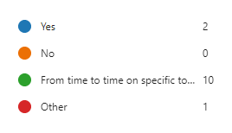
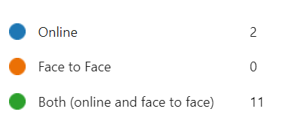
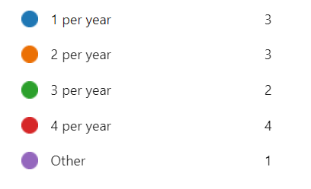
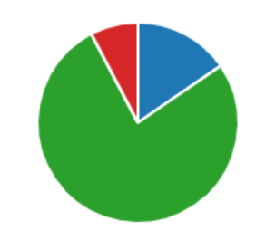
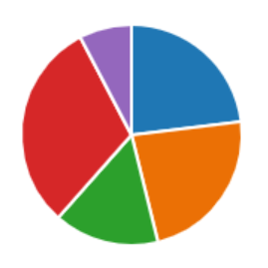
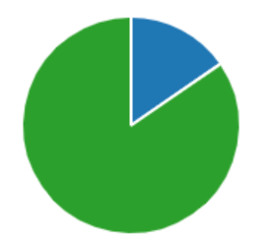
5. According to Terms of Reference roles of NFPTs and TSF differ. Should there be joint NFPT and TSF meetings?
6. What should be the format of the National Focal Points for Public Health Training meetings (online/face to face/both)?
7. What should be the frequency of the meetings among National Focal Points for Public Health Training?
Notes:
Additional comments
It has been useful with the shorter quarterly updates rather than trying to fit everything once a year.
for question 7, I put 2 per year if it is a mix of online and in place OR only online. But if only in place, then once a year is enough! For question 5, rather than from time to time with TSF I would suggest (as it has been done lately), to have one part only with NFP-T, and then together with TSF for the topics that concern both
The current system of having one joint TSF and NFPT meeting per year (in person/hybrid) works well.

Slide 28
Update from TSF discussion on 15 February about ways of working – Adam Roth
NFPT and TSF meetings:
- NFPT and TSF once a year face-to-face around ESCAIDE and continue with TSF Meetings Q1 to Q3 online.
- Keep smaller/less topics, relevant to only the fellowship and allow more time for discussion and time to provide input.

Slide 29
Break-out rooms

Slide 30
Discussion in break-out groups 25 minutes discussion + reporting back to plenary
Group 1 and Group 2
Taking into consideration the results of the survey, propose a list of topics to be discussed in 2024
Group 3 and Group 4
Taking into consideration the results of the survey, propose:
Frequency and format of NFPT meetings through the year
Frequency and format of collaboration with TSF
Ways of working with the public health training coordination committee

Slide 31
Group 1 and Group 2
Topics proposed in the survey
Exchanges
Senior exchange mid-career trainings
Particularly interested in seeing exchange visits re-started. This type of peer-learning is hugely valuable to MS
Competencies
New needs/competencies for PH training at national and EU level
core competencies in public health disciplines,
Fellowship
How can we involve more people in the supervision process in the context of lack of specialist/ human resources? Could it be possible to have a MS track fellow in a different place/ city than the acknowledged training site, with a supervisor from the TS, having regular meeting face to face and online and with project supervisors from the place/ city where the fellow is based?"
collaboration with EPIET associated programmes (EAPs)
Specific topics
reaching a wider audience with training opportunities provided by ECDC, beyond the national level
control measures to take when have to deal with a vector borne outbreak due to dengue/chikungunya or west Nile fever
balancing between preparedness and response
capacity assessment methodology
health task force
Taking into consideration the results of the survey, propose a list of topics to be discussed in 2024

Slide 32
Group 3 and Group 4
Taking into consideration the results of the survey, propose:
Frequency and format of NFPT meetings through the year
Frequency and format of collaboration with TSF
Ways of working with the public health training coordination committee
5. According to Terms of Reference roles of NFPTs and TSF differ. Should there be joint NFPT and TSF meetings?
6. What should be the format of the National Focal Points for Public Health Training meetings (online/face to face/both)?
7. What should be the frequency of the meetings among National Focal Points for Public Health Training?

Slide 33
Break
(15 minutes – back at 14:45)
Later:
Information items on Fellowship topics and Q&A
AOB

Slide 34
Information item on Fellowship topics and Q&A Adam Roth

Slide 35
How Fellowship will be included in EU Health Task Force (when/voluntary or obligatory participation/administrative processes)
Selection of C2024 and requirements for MS Track

Slide 36
EU HEALTH TASK FORCE
Supporting emergency preparedness and response in the European Union and globally
Emma Löf, on behalf of the ECDC Coordination Team of the EU Health Task Force
05/03/2024

Slide 37
New ECDC mandate – establishment of the European Union Health Task Force (EUHTF)
Background: shortcomings in EU mechanisms for managing threats, lack of readily available human resources for timely deployment -> need for a stronger EU deployable work force
ECDC new mandate establishes the EU Health Task Force to provide effective operational response and crisis preparedness support to EU/EEA Member States (MS) and wider global health security
ECDC creation and coordination of the EUHTF with support and collaboration of the European Commission, EU/EEA MSs and EU partners:
Flexible body, mobilised in different situations and under different mechanisms
Remote support as well as rapid in-country field deployment

Slide 38
Composition of the EUHTF
ECDC Coordination Team
Permanent entity coordinating EUHTF activities: Public health experts Emergency operations centre staff Administrative assistants
Enhanced Emergency Capacity
EUHTF pools including experts from: ECDC staff ECDC Fellows (e.g. EPIET, EUPHEM) EU/EEA Member State experts
Tasks
Tasks
Coordination, including for deployments
Development of administrative, readiness and mobilisation procedures
Training and capacity building activities
Communications and coordination with partners, including internal and external advisory bodies
Field deployments / missions
Remote technical support
Community of knowledge and practice
Regular meetings
Sharing experience, protocols, tools
Participate in trainings

Slide 39
Requesting EUHTF support
Who can request support: national health authorities; EC; WHO; GOARN; non-governmental organisations
Geographical scope: (in order of priority) EU/EEA countries, EU candidate countries, potential candidate countries, European Neighbourhood Policy countries and other partner countries
Criteria for EUHTF mobilisation:
focus on one country or one crisis
related to emergency preparedness or response work
associated with an infectious disease or an event of unknown origin
during limited time
with a clear public health impact for EU/EEA or globally

Slide 40
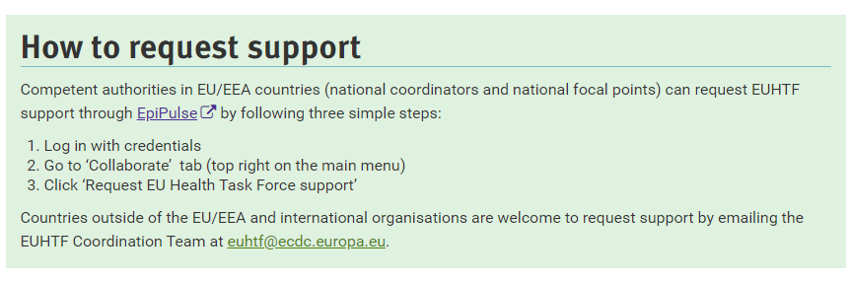
Requesting EUHTF support on the ECDC webpage
On the EUHTF webpage of the ECDC website -> instructions to request support
https://www.ecdc.europa.eu/en/about-ecdc/what-we-do/partners-and-networks/support-and-services-eueea-countries/health-task-force

Slide 41
Scope of activities supported by the EUHTF
Preparedness | Development, review of preparedness and response plans or guidelines/protocols related to specific technical areas | Surveillance, public health laboratories, infection prevention and control, EOC, points of entry, etc.
 | Testing of preparedness and response plans, or plans related to specific technical areas | Simulation exercise
 | Review implementation of preparedness and response actions | In-Action Reviews (IAR), After-Action Reviews (AAR)
 | Support implementation of capacity building activities | Actions identified through other activities (e.g. country assessments) or identified capacity building needs
Response | Threat detection and monitoring, including during outbreak or following disasters | Development, strengthening or operation of surveillance systems
 | Outbreak investigation and emergency response | Epidemiological investigations, rapid threat and risk assessment, molecular epidemiology, etc.
 | Emergency Operations Centre (EOC) | Develop and implement an incident management system, maintain and develop incident management tool(s)
 | Operational research in the context of an outbreak response | Develop protocols, cross border studies, data analysis, support for collaboration with external partners/stakeholder including relevant EU initiatives, etc.

Slide 42
Process to mobilise EUHTF support and expertise
Experts of Enhanced Emergency Capacity
Expert selection process
(a) Pre-established Expert pool
(b) Ad Hoc communication through focal points
Assignment
ECDC database
ECDC Coordination Team selects experts based on competencies and ToRs
Country of employment of the expert is informed (NFP/NC)
MS requesting support is informed
Expression of interest
EPIET Office
Request for support
Evaluate Request
Disseminating Requests
Closure of support
Requestor submits a request for support. For EU/EEA MS after agreement with the national NFP/NC
Form to request support (EpiPulse)
By email
Scoping call with ECDC
Decision to respond or not to the request
Clarify scope, timing, location, output
Include/align with NFP/NC
Dissemination of RfS and ToRs to the experts’ pool
NFP/NC cascade RfS and ToRs to national experts
Feedback from requestor
Feedback from expert
Debrief with requestor, NFP/NC and EUHTF team
Publication of report/mission outcome
Awareness and communication activities

Slide 43
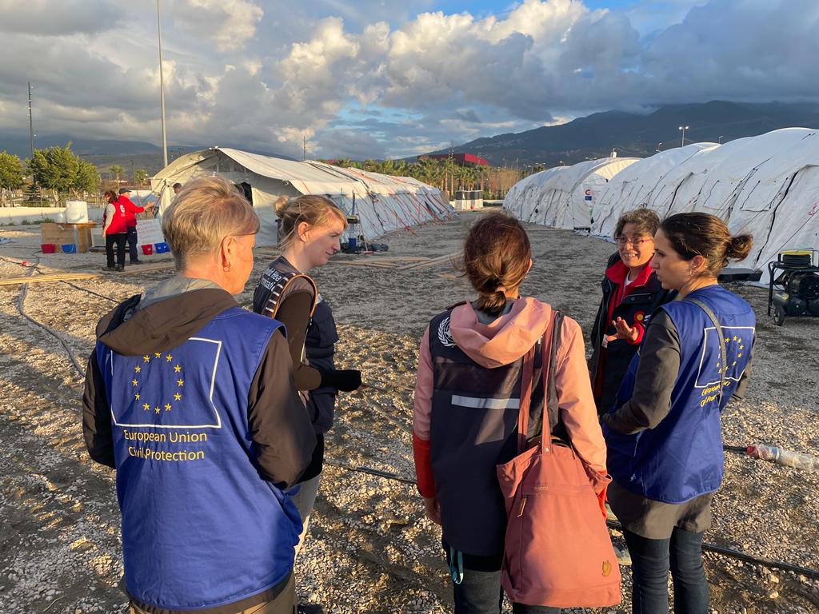
EUHTF Expert Profiles
Initial expert’s profiles for the EUTHF Enhanced Emergency Capacity:
Public Health Epidemiologist
Public Health Microbiologist
Public Health Preparedness and Response expert
Emergency operations centre (EOC) expert
Infection prevention and control (IPC) expert
Points of Entry/Border Health expert
Risk communicator
Note: Upon specific request for support, if a further expert profile is requested, ECDC will attempt to source support

Slide 44
Deploying fellows with the EUHTF
Fellows automatically part of the pool of Experts
ECDC EUHTF Coordination team contacts Fellowship office
Project opportunity form
ToR
International assignment
CV + Motivational letter
Supervised by ECDC Coordination team and/or ECDC staff

Slide 45
EUHTF funding
EUHTF routine expenses (cost for ECDC staff, EUHTF administrative operation and EUHTF work plan activities)
funded through the ECDC annual budget
Deployment related expenses (travel, accommodation, per diem)
covered by the organisation coordinating the deployment
ECDC
DG ECHO
GOARN
Expert’s salary
paid by the organisation employing the EUHTF staff

Slide 46
Update on ongoing/completed EUHTF assignments
Requestor | Technical Area/Topic | Status
France | Epidemic intelligence and response for two mass gathering events | Ongoing
Germany | AAR: coordination public health and international airports during COVID-19 | Ongoing
Ireland | Multi-country operational research: iGAS risk factors and surveillance | Ongoing
Latvia | Training on outbreak detection & investigation | Ongoing
Belgium | Simulation exercice on avian influenza | On hold
Ireland | Simulation exercice on avian influenza | On hold
Lithuania | After-action review (AAR): contact tracing during COVID-19 pandemic | Completed
Slovenia | AAR: resp. measures, vaccination and risk communication during COVID-19 | Completed
Slovenia | Guidance on national workforce capacity estimation | Completed
Ukraine | Rapid risk assessment related to a flooding event | Completed
Notes:
In addition to this, three new requests: -outbreak detection and investigation training (Latvia)
-EOC AAR in Slovenia -EpiPulse training in Montenegro

Slide 47
EUHTF assignments 2023
Maria João Cardoso EUPHEM fellow based in Austria worked on the EUHTF project on iGAS
Country | Date request | Technical Area/Topic | Support provided by EUHTF to date | Next actions
Ireland | 08/05/2023 | Multi-country operational research study on iGAS: risk factors and surveillance strategy | Developed protocol and database for data collection Data sharing agreement Engagement of EUPHEM fellow to support analysis Survey on surveillance system for GAS and iGAS Presentation at Public Health Protection Conference in Dublin 12/10/23 7 countries shared data, 1 still remaining | Data cleaning and analysis Manuscript or report or presentation at a conference Guidelines for surveillance
Notes:
Emma

Slide 48
EUHTF external governance bodies assisting the ECDC Coordination Team
 | Ad Hoc EUHTF Working Group: Support to establish EUHTF | EUHTF Advisory Group: Support operation of the EUHTF
Role | Assist initial set-up & arrangements Support adoption of administrative procedures & mobilisation framework of EUHTF Enhanced Emergency Capacity Support creation of the EUHTF Advisory Group | Advise and assist ECDC Coordination Team on: Operational, administrative and technical decisions Annual work plan priorities Opportunities for international collaboration
Members | ECDC, 6 selected MSs, EC DGs (SANTE, ECHO, HERA, RTD), WHO-GOARN | ECDC, 6 selected MSs, EC DGs (SANTE, ECHO, HERA, RTD), EMA, WHO-EURO, MSF, EUPHA
Timing | Quarterly meeting in 2023 | From 2024, meet every 6 months, two-year rotations
As per routine ECDC governance mechanisms, the EUHTF reports annually to:
ECDC Advisory Forum on EUHTF scientific work
ECDC Management Board on EUHTF workplan and budget

Slide 49
Members of the EUHTF Advisory Group
European Medicines Agency
Manuela Mura
European Public Health Association
Ricardo Mexia
Médecins Sans Frontières (MSF)
Daniela Garone
ECDC Coordination Team
Vicky Lefevre, chair - Head of Unit – Public Health Functions
Thomas Hofmann, Head of Section - Emergency Preparedness and Response Support
Ettore Severi – Lead EPR Readiness and Support Group
Adriana Romani - EPRS
Daniel Cauchi – EPRS
Dorothée Obach– EPRS
Emma Löf - EPRS
Hanh Vu Hong – EPRS
Katarina Johansson – PHF
Orla Condell – EPRS
Sara Forato - EPRS
Svetla Tsolova – EPRS
MS Representatives
Bernardo Guzmán Herrador, Spain
Claudia Siffczyk, Germany
Guido Benedetti, Denmark
Mairin Boland, Ireland
Otto Helve, Finland
Paula Vasconcelos, Portugal
European Commission DG representatives
Isabella Panunzi, DG HERA
Evelyn Depoortere, DG RTD
Laura Gillini, DG SANTE
Birgit Snoeren, DG ECHO
Alexandre Jully, DG ECHO (alternate)
GOARN representative
Gianluca Loi, GOARN OST
WHO EURO
Oleg Storozhenko
Adela Paez (alternate)
Notes:
Ettore

Slide 50
Thank you

Slide 51
Selection of C2024 and requirements for MS Track Adam Roth

Slide 52
Cohort 2024 Selection EU – Track
Candidate interviews with the Selection Committees
22-26 January
EUPHEM online Training Site Market – Information available on EVA
11-12 March
EPIET online Training Site Market - Information available on EVA
13-15 March
Director signs selection report
Early April

Slide 53
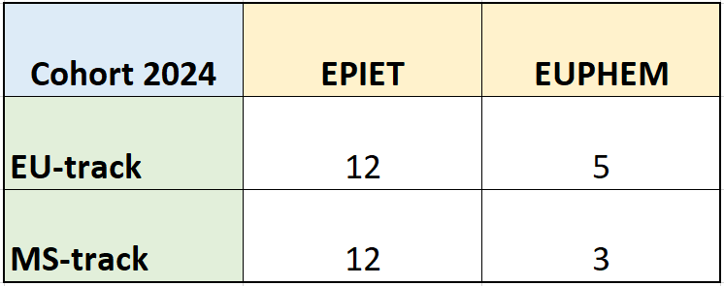
Cohort 2024 Allocation of Seats
See 18/01/2024 ECDC Courses Courses@ecdc.europa.eu email for details.

Slide 54
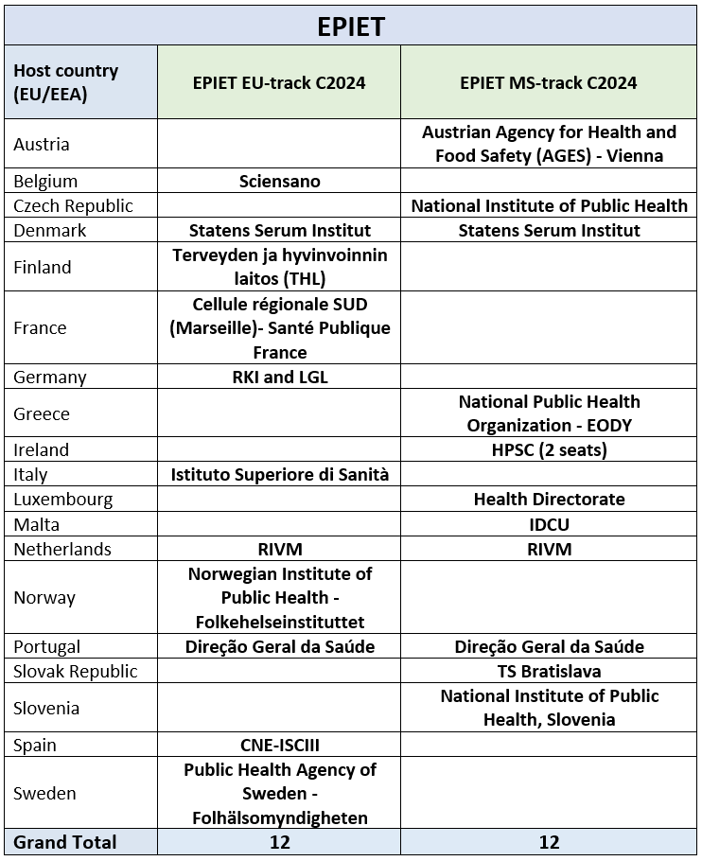
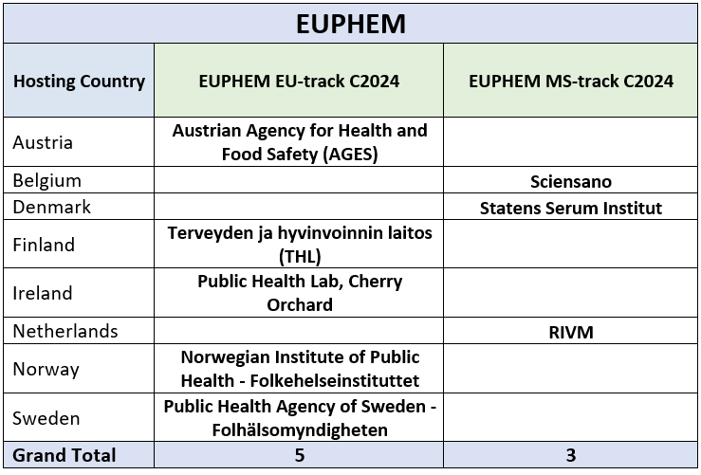
Cohort 2024 Selection

Slide 55
Selection Cohort 2024 MS Track
The AD for 2024 is under revision
The AD for C2023 can be found on ECDC website
NFPTS and TSF Have been informed of the allocation of seats and start looking for suitable candidates
The Selection process will be launched in the beginning of April
Interviews will take place in May – June

Slide 56
Selection Cohort 2024 MS Track
Eligibility Requirements of candidates for the MS-Track:
In order to be eligible for the ECDC Fellowship Programme, candidates for both paths need to fulfil the following set of formal requirements:
Have a thorough knowledge (minimum B2) of at least two official languages of the EU/EEA, one of which shall be English;
Be a national of a Member State of EU/EEA; and
Be entitled to her or his full rights as a citizen.
*Member States that have been allocated an MS-track post in the EPIET/EUPHEM training may engage in a process to select suitable candidates among their current workforce or open a selection process to recruit new staff

Slide 57
Selection Cohort 2024 MS Track
Specific eligibility requirements for EPIET Path:
Completed post-secondary education (university studies) of at least 3 years attested by a diploma1 in medicine, public health, epidemiology, veterinary medicine, nursing, biology, microbiology, pharmacology, bioinformatics, biomedicine or other health and social sciences, at the level of graduate diploma, Masters’ degree or equivalent;
At least two (2) years of work experience in public health or applied epidemiology. Specific eligibility requirements for
EUPHEM Path:
1. Completed Post-secondary education (university studies) of at least 3 years attested by a diploma2 in medicine, biology, microbiology, veterinary medicine, pharmacology, bioinformatics, or biomedicine, at the level of graduate diploma or Masters’ degree or equivalent;
At least three (3) years of working experience in microbiology; or a PhD degree in microbiology or equivalent (e.g. clinical microbiology specialisation, veterinary medicine specialisations, or a specialisation in any microbiology field).

Slide 58
Selection Cohort 2024 MS Track
Selection criteria/ Professional skills and experiences:
Proven experience in public health and/or epidemiology (EPIET)
Scientific background in microbiology, and skilled in microbiological techniques and softwares (EUPHEM) • Good scientific background in epidemiology, and a basic knowledge of biostatistics (EPIET) Personal characteristics/interpersonal skills
Strong commitment to field epidemiology (EPIET)/public health microbiology (EUPHEM) in the EU
Good organisational skills
Ability to work in interdisciplinary teams, manage a broad range of responsibilities and competing priorities
Good command of scientific writing and oral communication in English Advantageous criteria
Previous experience in public health and/or epidemiology (EUPHEM)
Ability to undertake independent working, demonstrating logical, analytical and innovative thinking
Experience of international activities and multicultural awareness
Understanding the public health regulatory framework and requirements in the Member States
Skills in epidemiological/biostatical analysis and software

Slide 59
Questions Regarding Selection please email: ecdc.epietfellow@ecdc.europa.eu

Slide 60
AOB

Slide 61
EVA Catalogue
Upcoming Summer School 2024
Topic: Introduction to mathematical modelling and strategic foresight for assessing and anticipating threats in public health
Face for face at the ECDC: 22-24 May 2024,
Message for nominations to be sent out to NFPTs shortly (new ECDC nomination tool) – one participant per country (and one alternate)
Recovery e-learning

Slide 62
Conclusions and next steps Adam Roth

Slide 63
Thank you for your attention

